Slide 1

HISC 5 YEAR PLAN
Slides 2 to 36 are the presentation given by the General Committee team at the SGM on 27th April 2025. Slides 37 onwards were signed off by GC.

Slide 2
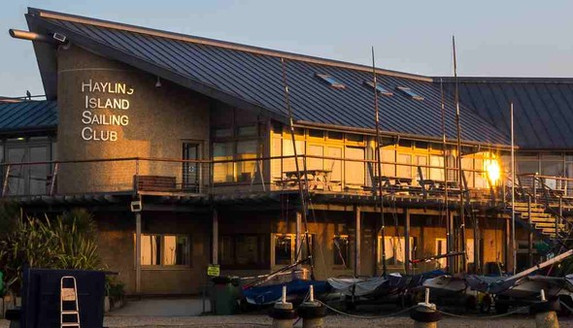
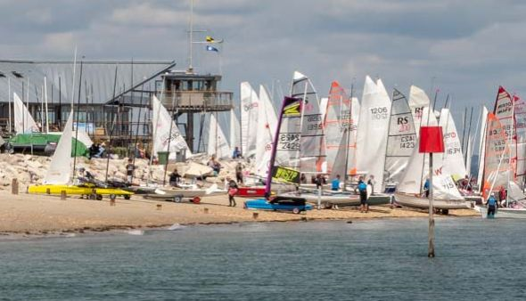
HAYLING ISLAND SAILING CLUB
5 Year Plan Update
APRIL 2025

Slide 3
OBJECTS OF THE CLUB Rule 3
CLUB CULTURE - Developing and nurturing a club culture based on social interaction, member engagement, team spirit and safety PARTICIPATION - Facilitating and encouraging participation and enjoyment of all forms of sailing and watersports as approved by the General Committee SAILING EXCELLENCE - Inspiring current and future generations in the pursuit of sailing excellence CHAMPIONSHIP VENUE - Offering world class events and championship ENVIRONMENT - Protecting and sustaining our local natural environment FINANCIAL SUSTAINABILITY - Ensuring financial sustainability for the Club, its resources and facilities

Slide 4
HISC 5 YEAR PLAN Process
Rules
Objects (Rule 3)
Principles
New Issues
Review & Revise
Assess Outcomes
Agree next steps
Notes:
New Issues: Sport developments eg RYA restructure of the RTG, emergence of new variants of the sport ie wingfoiling, Member Initiatives/ Resolutions, Legislation Changes

Slide 5
OBJECTIVE 1 – CLUB CULTURE
Sophie Costard
Vice Commodore House

Slide 6
2024 Highlights
Various indicators show that House has had the best year since 2015 Without your continued support progress cannot happen Higher member engagement on Food & Beverage spend in 2024

Slide 7
HOUSE ACHIEVEMENTS IN 2024
Major improvements in the “hotel” services - Wednesday Evenings – up to 150 covers in the height of the summer Sunday lunches – impressive & consistent, low wastage

Slide 8
HOUSE ACHIEVEMENTS IN 2024
Sunday Lunches Sold to end of March 2025

Slide 9
HOUSE ACHIEVEMENTS IN 2024
Major improvements in the “hotel” services Wednesday Evenings – up to 150 covers in the height of the summer Sunday lunches – impressive & consistent, low wastage Back to regular talks in the Autumn/Winter months Feedback is much more positive ABBA tribute band Investment in growth in corporate events and weddings

Slide 10
HOUSE ACHIEVEMENTS IN 2024
Stronger focus on Estates Successful Estates sub-committee pilot, with strong maintenance and renewal planning New boiler and central heating replacements successfully installed Huge engagement from Dunes Gardening team, still 38 strong, to enhance the external environment HISC Archives delivered an 80th Anniversary COPP dinner

Slide 11
ONGOING OBJECTIVES
Continue to strive for consistent delivery on food in all areas, buzzer, Sunday lunches, Wednesday/Thursday evenings & Beach Bar Members’ parties, milestone birthday celebrations Maximising return outside core Club times and from external sources: Build on external corporate bookings Weddings Necessary refresh of all the Dunes rooms by the end of June, within budgetary restraints Stocker review ongoing, with required re-cladding in 2026 Key Estate maintenance items completed, e.g. balcony repairs

Slide 12
THANK YOU
House Committee – Allison Rogers, Nick Peters, Mark Darling, Ossie Stewart, Anna Wells & Lara Jameson Peter Bannister, Estates & Judith Williamson, Social Gardening The new archive team, Leonie Austin, Leah Blake & Pam Marrs Nick Griffiths & the House Team Here’s to an even better 2025, continuing to build on our successes!

Slide 13
OBJECTIVES 2,3,4
2 - Participation, 3 - Sailing Excellence, 4 - Champs Venue
Sarah Mitchell
Vice Commodore Sailing

Slide 14
EXTRA VOLUNTEERING
Member Involvement - getting stuck in and going the extra mile Additional Duties – inc Major event race teams and RO Taking on whole projects: WOW Thursday Club Windsurf Lockers Automated Starting Sequencing Use It Or Lose It! Wall of Fame New Tender Team Seals and more

Slide 15
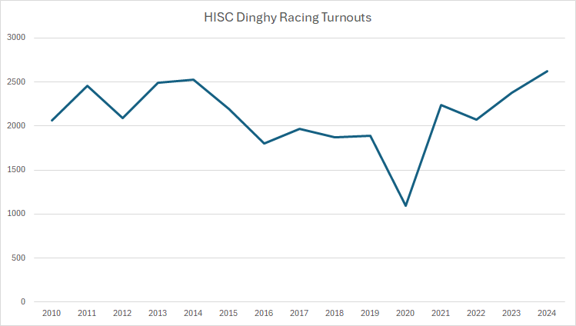
SAILING HIGHLIGHTS IN 2024
Use it or Lose it (year 3) Boat Park Work Party Cleared Waiting List Making space for new members Highest turn out in Club Racing since 2010

Slide 16

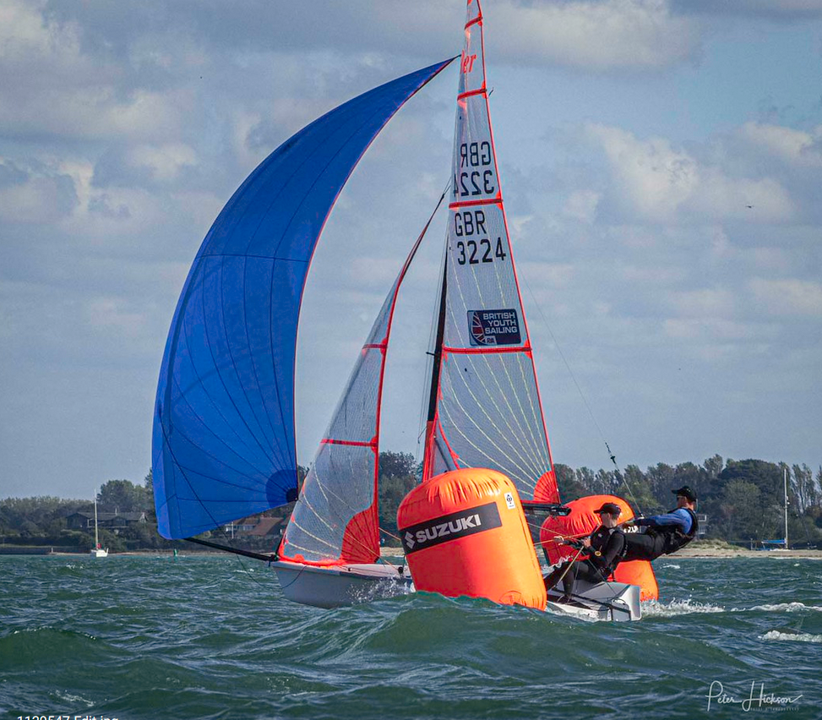
SAILING HIGHLIGHTS IN 2024
The Soak Tide Ride - Resurrected a classic event Spectator Event Big Party! Big Prizes!

Slide 17

SAILING HIGHLIGHTS IN 2024
Advances in Technology
Club Racing online entry Club Racing Signing on Tablets QR codes for UIOLI Open Meeting and Championship online entry Race box assistance
HISC WhatsApp Communities Dinghies and Keelboats Cruisers HISC Wing Surf/Foil Exchange of ideas /advice Informal sailing Finding crews And so much more

Slide 18
CHAMPIONSHIP VENUE
- FORWARD PLANS
2025 | 2026 | 2027
ILCA UK Masters ILCA Masters Europeans Europe Youth & Masters Europeans 2000 Nationals Musto Skiff Nationals RS 21 Nationals | 505 Worlds RS400 Nationals RYA Youth Nationals * Feva Nationals* Elite Nationals ILCA Nationals | Aero Nationals 29er Nationals Feva Nationals
2028 –
RS200 Nationals
Wayfarer Internationals (Race Week and Rally)
* Currently in negotiation

Slide 19
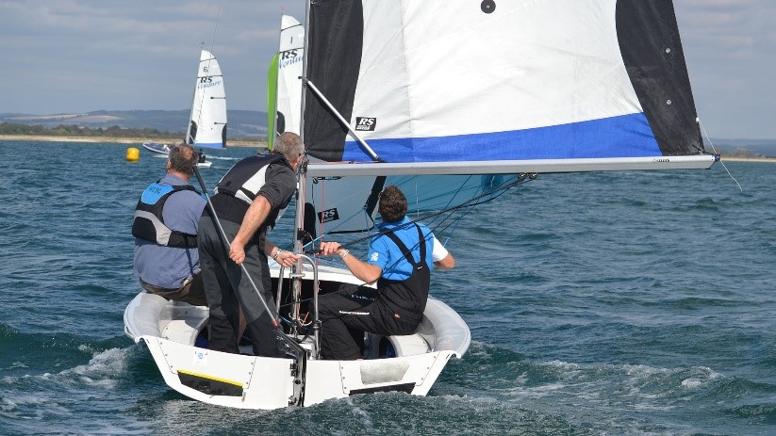
ONGOING OBJECTIVES
Build more windsurf lockers Develop and implement ideas to support our growing wingfoiling community Launch Assisted Sailing for our less mobile members Another great season creating sailing memories.

Slide 20
THANK YOU
Sailing Committee Rear Com Racing - David Hitchcock and his committee Rear Com Cruising - Guy McBride and his committee Past Rear Com Youth - Becks Kent and all the very active youth parents, both in and out of committee Damon Repton - our Safety Lead, Angus McIntyre - our Boardsports Lead, Fiona Sayce and Rob Wilder. Marine Team and Office Team Class Captains Special thank you Peter Hickson, Simon Benson and Chris Turner

Slide 21
Objective 5 - ENVIRONMENT
2024 ACHIEVEMENTS
Emma Toman is Environmental Lead for HISC, also active representative with Chichester Harbour Federation Environmental Group.
Continued with the good work to date
  The Borrow bag initiative – made more bags and rolled out to the local community
  Successful site litter picks
  Better recycling
  Reduced plastics relating to food and drink
  Food waste management
  Ongoing campaign to discourage prolonged use of showers and hot water
  Tracing and mending water leaks
  Education sessions by The Final Straw
Challenges
Investment and priority for environmental issues above operational commitments

Slide 22
ENVIRONMENT
FORWARD PLANS
Implement the community-financed proposal for PV panels with Energise South Downs.
Further implementation of actions to reduce single use plastics and work towards silver accreditation from The Final Straw, once their updated framework is published.
ILCA clean regatta (using Sailors for the Sea framework).
Continued communications and education via newsletter, website and specific events.
Work with the cruising community to minimise environmental impact of their harbour activities, including anti-fouling.
Continued focus on reduced water use on site, including identifying and fixing leaks in hosepipes and minimizing time in showers.
Continued research on environmental initiatives for progression when funding available.
Maintain close liaison with the Conservancy, CHaPRON, Coastal Partnerships with regard to coastal management.

Slide 23
ENVIRONMENT
FORWARD PLANS
Implement the community-financed proposal for PV panels with Energise South Downs.
Photo Voltaic Array to main club roof
Nil capital outlay to HISC
Agreed Heads of Terms
Move to contract once satisfactory structural survey completed
Planning approved
Installation due during 2025
Immediate reduction in electricity bills
15 Tonnes of Co2 saved each year
Reduced reliance on power suppliers
Notes:
Perhaps most significant environmental progress of recent years

Slide 24
ENVIRONMENT
FORWARD PLANS
Implement the community-financed proposal for PV panels with Energise South Downs.
Work towards silver accreditation from The Final Straw by implementing actions to reduce single use plastics
ILCA clean regatta (using Sailors for the Sea framework)
Continued communications and education via newsletter, website and specific events
Work with the cruising community to minimise environmental impact of their harbour activities, including anti-fouling
Continued focus on reduced water use on site, including identifying and fixing leaks in hosepipes and minimizing time in showers
Continued research on environmental initiatives for progression when funding available.
Maintain close liaison with the Conservancy, CHaPRON, Coastal Partnerships with regard to coastal management.

Slide 25
Financial Report for the Year Ending 31st December 2024

Slide 26
Year End 31st December 2024
Summary Financial Statement
The financial result for the year shows an overall contribution of £97,974. This is an improvement of £79,231 over last year when we recorded a profit of £18,743 and is the best result since 2014.
Income increased by 8% across all areas
Costs increased by 5%
We generated approximately £31,000 of cash.

Slide 27
Year End 31st December 2024
Marine
Boat Parking and Mooring income increased in line with the increases set last year.
Event income grew to £101,493 (2023, £91,216)
Training and Hire increased by £16,301
Cost increases was contained at 3.9%
Notes:
Marine Income
Income increased from £668,951+ in 2023 to £761,810 vin 2024 (an increase of £92,859). For the second year in a row Boat Parking and Mooring income increased in line with the increases set last year.
Event income at £101,493 was £10,277 higher than last year
Training and Hire increased by £16,301.
Marine Costs
Costs increased by £22,747.
Wages grew by only 2%, a considerable achievement given the large rises in employment costs, especially the minimum wage increases which disproportionally affect our summer work force
Repairs and Maintenance fell by 12% to £64,465, this was achieved by improving skills within the marine team, bring maintenance inhouse and the cheaper running costs of the new Suzuki engines.
Engines by Suzuki. = lower operating costs + restructure of marine

Slide 28
Year End 31st December 2024
House
Notes:
High summer demand / low winter demand
High inflation
Recruitment issues

Slide 29
Year End 31st December 2024
Membership
Membership subs increased by 11% but actual income only increased by 4%.
There is a shift away from family memberships into other categories or leaving.
Notes:
328 less “yuffs” than 2018

Slide 30
Year End 31st December 2024
Admin and General Costs

Slide 31
Year End 31st December 2024
Keeping the club going
The club generates enough cash to fund day to day operations.
Last year we were able to fund £322,000 of repairs and renewals
But with cumulative losses since 2016 of £376,000 we have limited cash reserves. Covid provided a sizable cash injection, and since then we have lived within our means.
We have some major expenditure in the pipeline – funding that will be challenging.
This year's budget is for a 45,000 surplus which is below our long term target requirement – but will fund our cap ex for 2025
Notes:
We have made progress, stuff on cash

Slide 32
Financial Thinking 2025 onwards
To budget to make annual surplus to fund Capex and catch-up maintenance

Slide 33
Financial Thinking 2025 onwards
Planned Capex for 2025 to 2027
Replacement of the Freezers to the kitchen (£18.5k)
Phased replacement of the balcony beams with Oak (£150k)
Fire Safety Recladding of Stocker Block (£60k)
Repair of the entrance roadway (£48K)
Repair of the causeway gabions (£110k)
Refurbishment of the changing rooms and toilets (£20K tbc)
Replace Dunes Block showers (£10K)
Sleeper replacement around the estate (£15k)

Slide 34
Financial Thinking 2025 onwards
To budget to make annual surplus to fund Capex and catch-up maintenance
Start to build a cash reserve – notionally equal to our committed outgoings
Key Question:
What do we want our club to look like in 20 years' time (2045)
Notes:
Underpinning planning - Key Question that we have been working around. Looking at changes in last 20 years since 2005, dinghy fleets have generally reduced, foiling has taken over the world, other sailing clubs are relying on rowing

Slide 35
Summary
Met our financial objective for 2024 which was to generate a surplus of £100k to meet our CAPEX requirements for the year
'On Water' activities continue to make very positive contribution
Contribution of 'Off Water' activities is better now than for some years – revenue from our accommodation brought House into a cash surplus position
Costs are being kept tightly under control
Decline in membership numbers continue to be a challenge – particularly Family memberships, some changing to Adult Single or Adult Couple (without Children)
While we are heading in the right direction, there remains more to do

Slide 36
Thanks are due to..
Dave Nicholls
Henry Message
Notes:
DN 30 years of club service. Was elected RC Sailing towards the end of the last century, and has since held most of the senior elected offices including Commodore, VC House, Chair of Membership, and most latterly a Trustee. Dave was also for many years an active Race Officer for Open Meetings and Nationals at HISC.

Slide 37
OUR AGREED OBJECTIVES as defined in the Rules
The objects of the Club shall be to promote excellence in racing under sail and to encourage cruising under sail and/or power through: - Developing and nurturing a club culture based on social interaction, member engagement, team spirit and safety - Facilitating and encouraging participation and enjoyment of all forms of sailing and watersports as approved by the General Committee - Inspiring current and future generations in the pursuit of sailing excellence - Offering world class events and championships - Ensuring financial sustainability for the Club, its resources and facilities - Protecting and sustaining our local natural environment

Slide 38
OBJECTS OF THE CLUB
Each object has a short label, for ease of reference: - Developing and nurturing a club culture based on social interaction, member engagement, team spirit and safety = CLUB CULTURE - Facilitating and encouraging participation and enjoyment of all forms of sailing and watersports as approved by the General Committee = PARTICIPATION - Inspiring current and future generations in the pursuit of sailing excellence = SAILING EXCELLENCE - Offering world class events and championships = CHAMPIONSHIP VENUE - Ensuring financial sustainability for the Club, its resources and facilities = FINANCIAL SUSTAINABILITY - Protecting and sustaining our local natural environment = ENVIRONMENT

Slide 39
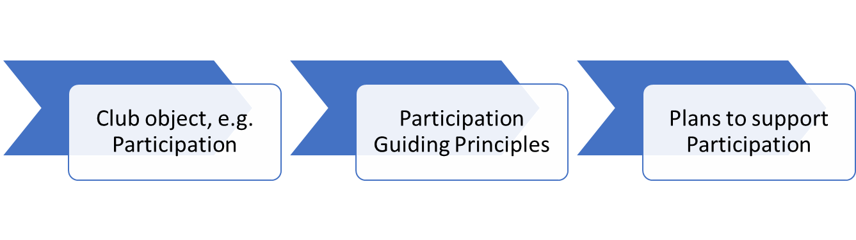
GUIDING PRINCIPLES AND PLANS
Our 1 to 5-year plans must underpin the achievement of our objectives. Guiding principles for each objective have therefore been defined to provide clarity of direction and common goals. Action planning will be guided by the principles. The principles and plans will be reviewed and updated each year. Progress v associated plans will be reviewed regularly at Committee meetings.

Slide 40
CLUB CULTURE PRINCIPLES
“Developing and nurturing a club culture based on social interaction, member engagement, team spirit and safety” Promote a welcoming and inclusive atmosphere for all members and visitors Provide a calendar of social events with broad appeal across all age and activity groups Encourage all members to actively engage with the Club and everything it offers Encourage collaboration and mutual support between members and crew Offer food and beverage which is good value, appropriate and timely to support the different Club activities Deliver regular and informative communication with members, working with the website as the go-to place for accurate, up-to-date, easy-to-access, information about the Club and all its activities Broaden opportunities for members to support the Club as a community with their expertise and professional skills Grow understanding of our members' and visitors' needs and wants through feedback mechanisms Support and protect the Club’s history and collective memory.

Slide 41
CLUB CULTURE - 2024 ACHIEVEMENTS
Volunteer’s reception to thank members and their spouses for their valued input Social Gardening Group renovated & replanted the Eastern side of the North Mezzaine & the Stocker block. Have supplied the kitchen with herbs. Sterling work from the watering crew. Dinghy Park work parties continue with great sense of community Estates Work Party achieved balcony deck cleaning, Dunes downpipe replacement & overflow car park hedge trimming The Archives Team ran a successful COPP 80th Anniversary dinner & attended the Christmas Fair in 2024 The Class Captains’ Forum and WhatsApp communities continue to grow from strength to strength Challenges How to maintain and grow volunteers to cover all duties, working parties, etc.

Slide 42
CLUB CULTURE - 2024 ACHIEVEMENTS continued…
We have developed a strong catering team Continued careful management of casual/catering/bar staff Built on a strong Club social programme with key member events – Easter Weekend, Summer Ball, Abba Night on the Saturday of August Bank Holiday, Kids Christmas Party, Christmas Party, Turkey Dining and NYE as repeat annual events. Planters, lamps, lighting in all dining & bars & uplift of lounge bar have improved the ambience in the Club Ran successful talks over weekends to encourage working/distance members to attend

Slide 43
CLUB CULTURE – FORWARD PLANS
TO DO
Hold a Volunteers thank you party each year
Continue to build on quality catering and social programme, fulfilling all members expectations
With renewed confidence in our team and facilities, active promotion of the Club as a premier corporate and wedding venue in off season and quiet periods
Cost efficient refurb & deep clean of Dunes & Stocker block
New balcony seating
Social Gardening Group will continue to maintain the site and ensure the planting that took place in 2024 is well established
Ongoing commitment from the Archive team to maintain and grow the Club's historical records.

Slide 44
PARTICIPATION PRINCIPLES
“Facilitating and encouraging participation and enjoyment of all forms of sailing and approved watersports” Aim to grow participation levels across all areas Continue to develop the training offering Facilitate our members to develop the relevant skills to support Club activities Continue to develop the hire model Support and encourage Class-driven and other group activities Encourage high levels of parental involvement and competency in all our watersport activities

Slide 45
PARTICIPATION – 2024 ACHIEVEMENTS
Highest Club dinghy racing turnouts since 2010
Notes:
The data on this chart seasm to be wrong, I have a list of the correct data , when I cant find it – I took a pic on my phone!

Slide 46
PARTICIPATION – 2024 ACHIEVEMENTS
Dinghies – adult and youth Highest club racing turnouts since 2010 WhatsApp groups continue to build and strengthen links between fleet members and facilitate informal training and sailing Good take-up when Youth and Juniors encouraged to take part in main harbour racing. Strong teen/parent crew participation Youth Pathway continues to be strong- Seals – Red Ribbon – Youth Training Week – Easter Race Camp – Summer Training Camp, then full class Winter Training Programme Youth Winter Training brings in many Winter Members for Opi and 29ers, many of which then join as families. This year, Fevas have had a resurgance which is VERY good to see 505’s are the new fleet for 2024, in preparation for the Worlds being hosted at HISC in 2026

Slide 47
PARTICIPATION – 2024 ACHIEVEMENTS continued…
Board Sports Paddle Sport event hosted for second year – great entertainment value Wingfoiling strategy and code of conduct completed, working closely with Club members and the Harbour Master Wingfoiling included in the supported board sport sessions Growth in interest in the Round Hayling event Cruising Continued enjoyment of cruising community activities, local and further afield

Slide 48
PARTICIPATION – 2024 ACHIEVEMENTS continued…
General Return of the Tide Ride – fun, fast event – great for spectators as well as competitors Possibly the strongest female engagement in our sports at club level nationally, spurred by WOW and She Flies, and great female role models. Strong female participation in club racing Aligned registration for all Club-approved craft Challenges Long term concern over the national trend in the sport – a decline in participation Reduction in volunteering ethos, both in duties and major roles such as Rear Com Youth Family time is stretched between sailing and other sports

Slide 49
PARTICIPATION – FORWARD PLANS
Update the hire fleet to better meet the needs of the membership
Evaluate the training offering to ensure we are delivering the right type and amount for our members which is economical for the Club
Keep the focus on fleet captains
Maintain the breadth of racing programme with a focus on special events
Continue to develop and implement a plan to support and grow board sports both recreationally and competitively
Plan to grow spectator events following the success of the Tide Ride
Review handicaps; bay racing now on PY handicaps to encourage large double- handers back
Find new boat parking spaces
Introduce Blind and Assisted Sailing for our less mobile / physically able members

Slide 50
SAILING EXCELLENCE PRINCIPLES
“Inspiring current and future generations in the pursuit of sailing excellence”
Offer improvements pathways appropriate to the needs and wants of different types of sailors
  E.g. cross channel, WOW
Recognise and celebrate achievement at all levels
Support and encourage fleet racing, training and other skill-improving activities

Slide 51
SAILING EXCELLENCE
- 2024 ACHIEVEMENTS
HISC members continue to achieve success in a variety of Classes at home and abroad, including representing GB at the Olympics.

Slide 52
SAILING EXCELLENCE
- FORWARD PLANS
Strengthen the links between junior/ youth and adult sailing, e.g. Junior and adult fleets joining up for Sprint racing.
Build on our achievements of excellence to inspire members through guest speakers and race officers
Encourage the watersports communities to be included in mainstream events, eg restoring Tide Ride
Continue to develop and support Club-led and member-led training activities.
Develop WhatsApp groups to link other areas of the community, such as a Race Officer group to help develop our resources

Slide 53
CHAMPIONSHIP VENUE PRINCIPLES
“Offering world class events and championships” Develop a pipeline of event bookings which are rewarding: for our members for participants financially reputationally Build and maintain strong relationships with specific classes Further develop wider large event management expertise Build and maintain strong relationships with RYA senior management and departments to ensure HISC is considered a prime venue for any significant event Ensure the right balance between events and member activities

Slide 54
CHAMPIONSHIP VENUE
- 2024 ACHIEVEMENTS
29er Grand Prix Contender, Osprey Open 505 Southern Championship and Fireball Spring Championship RS 30th Anniversary Regatta Flying Fifteen Bulwark Trophy Europe UK National & Open Championship Optimist Open Rs Elite Southern Area Championship Finn National Championship Solo Southern Area Champs, Travellers Series & Tyler Trophy Youth Race Week RS Aero World Championship Round Hayling Challenge RS700 & RS800 National Championship Chichester Harbour Race Week Sparkes Trophy Nab Cup PRCC Challenge Cup ILCA Masters UK National Championship Tide Ride RS Feva Grand Prix
Successfully delivered all major events and received excellent feedback from competitors.
Challenges
To manage provision of facilities for Members and Visitors at peak times
Providing volunteer race support for Championships, especially mid-week

Slide 55
CHAMPIONSHIP VENUE
- FORWARD PLANS
Continue to implement our plans to develop trained and skilled volunteers for key Race Management roles Actively approaching classes with appropriate events to build our pipeline of events beyond 2026, and up to five years ahead Youth Nationals 2026 Attendance at RYA Dinghy Show to promote the Club as a Championship venue Pro-active planning to ensure members can easily access the Club during large events

Slide 56
CHAMPIONSHIP VENUE
- FORWARD PLANS
2025 | 2026 | 2027
ILCA UK Masters ILCA Masters Europeans Europe Youth & Masters Europeans 2000 Nationals Musto Skiff Nationals RS 21 Nationals | 505 Worlds RS400 Nationals RYA Youth Nationals Feva Nationals* Elite Nationals ILCA Nationals | Aero Nationals 29er Nationals Feva Nationals
2028 –
RS200 Nationals
Wayfarer Internationals (Race Week and Rally)
* Currently in negotiation

Slide 57
FINANCIAL SUSTAINABILITY PRINCIPLES
“Ensuring financial sustainability for the Club, its resources and facilities” Grow our membership without undermining the offering Deliver sustainable cash flows to enable the Club to meet its current and future objectives Consider fund raising as an acceptable income stream Consider alternative income streams/funding arrangements to fund specific capital expenditure Maximise the use of Club land for the benefit of the Club, its members and visitors Ensure effective and cost-efficient crew team structure and working practices Maximise revenue generation from the Club facilities from non-member activities with minimal impact on the membership, e.g. at off-peak times. Continue digital developments to support communications, marketing and operational efficiency and effectiveness Embrace long term planning and future thinking to ensure Club assets are well maintained and renewed where necessary Ensure the Club and its operations meet all relevant statutory obligations

Slide 58
FINANCIAL SUSTAINABILITY
- 2024 ACHIEVEMENTS
The financial result for the year shows an overall contribution of £97,974. This is an improvement of £79,231 over last year when we recorded a profit of £18,743 and is the best result since 2014. Income increased by 8% across all areas and costs increased by 5% We generated approximately £31,000 of cash. ​ Challenges The club generates enough cash to fund day to day operations. Last year we were able to fund £322,000 of repairs and renewals But with cumulative losses since 2016 of £376,000 we have limited cash reserves. COVID provided a sizable cash injection, and since then we have lived within our means. We have some major expenditure in the pipeline – funding that will be challenging. Declining member numbers, particularly family memberships, are a continued concern.

Slide 59
FINANCIAL SUSTAINABILITY
- 2024 ACHIEVEMENTS continued
Partnership deal with Suzuki agreed, delivering savings on engine purchases and some new items of kit Operational cost savings of £25k delivered ​ANPR barrier to overflow car park installed Pontoon re-built and re-installed Improved car parking availability for members during events Hot water & central heating existing plant replaced with new installation including 3 new Ideal 120kW boilers and 2 new 400 litre buffer vessels. Completed initial review regarding incorporating the Club Improvements made to members and visitors race entry experience

Slide 60
FINANCIAL SUSTAINABILITY
- FORWARD PLANS
Develop a long term plan for the Stocker building Commission the new ferry due to arrive late Spring 2025 Agree a flood protection plan (for North side of the Estate) so that regulatory approvals can be sought Replace the causeway existing gabions to protect the integrity of the causeway Determine the way forward for the entrance access road Continued work and consultation on Club incorporation Continued liaison with planning officer for discussions about our land, overflow car park, etc.

Slide 61
ENVIRONMENT PRINCIPLES
“Protecting and sustaining our local natural environment”
Collaborate with and support local initiatives which are driving positive environmental change, e.g. water quality
Align with the RYA's The Green Blue scheme
Achieve the gold standard accreditation on the removal of single use plastic (via The Final Straw)
Strive towards a more carbon neutral status
Educate and inform our membership about environmental issues, plans and progress pertinent to the Club and its environment.

Slide 62
ENVIRONMENT
- 2024 ACHIEVEMENTS
Continued with the good work to date
  The Borrow bag initiative – made more bags and rolled out to the local community
  Successful site litter picks
  Better recycling
  Reduced plastics relating to food and drink
  Food waste management
  Ongoing campaign to discourage prolonged use of showers and hot water
  Tracing and mending water leaks
  Education sessions by The Final Straw
Challenges
Investment and priority for environmental issues above operational commitments

Slide 63
ENVIRONMENT
- FORWARD PLANS
Contract and deliver the community-financed proposal for PV panels with Energise South Downs.
Further implementation of actions to reduce single use plastics and work towards silver accreditation from The Final Straw, once their updated framework is published.
ILCA clean regatta (using Sailors for the Sea framework).
Continued communications and education via newsletter, website and specific events.
Work with the cruising community to minimise environmental impact of their harbour activities, including anti-fouling.
Continued focus on reduced water use on site, including identifying and fixing leaks in hosepipes and minimizing time in showers.
Continued research on environmental initiatives for progression when funding available.
Maintain close liaison with the Conservancy, CHaPRON, Coastal Partnerships with regard to coastal management.

